Slide 1
2018-2019 Annual report

Slide 2
Fiscal Year | ECHIP Renewal Average For its Members | Regional Medical, Rx Trends | % Savings for all ECHIP Members
2013-2014 | Renewal increases ranged from (-2%) to 19% - Group average was 11% | 12% to 13% | Averaged 1% savings over expected trend
2014-2015 | Renewal increases ranged from (-2%) to 8%- Group average was 6.4% | 12% | Averaged 6% savings over expected trend
2015-2016 | Group average was 2.7% | 10% | Averaged 7% savings over expected trend
2016-2017 | Renewal increases ranged from (-2.5%) to 7.2% - Group average is 2.6% | 9.5% | Averaged 7% savings over expected trend
2017-18 | Renewal increases ranged from (-0.1%) to 21.9% - Group average is 9.6% | 12% | Our first challenging year but still managed to be 1% under trend
2018-19 | Renewal increases range from 0.7% to 19.2% - Group average is 5.6% | 12% | Stop Loss Renewal with $160K ISL is +26% - moving up to $175K renewal reduced ISL renewal to 15.86%

Slide 3
2019-20 Renewal
7/1/18 – 6/30/19
Total claims & Expenses
PCPM
7/1/19 – 6/30/20
Projected Total claims & expenses PCPM
Rate Increase
2019-20
Coventry $1,641
Eastconn $1,216
Plainfield $2,004
Putnam $1,474
Tolland $1,717
Coventry $1,706
Eastconn $1,450
Plainfield $2,145
Putnam $1,487
Tolland $1,730
Coventry 4.0%
Eastconn 19.2%
Plainfield 7.1%
Putnam 0.9%
Tolland 0.7%

Slide 4
Stop loss ratio
2016- 17 Stop Loss deductible @ $150k
Everest re paid $1,445,174 in claims – we paid $1,598,486 in premium = 90% loss ratio
($153,312 gross profit)
2017-18 stop loss deductible @ $160K
Everest re paid $1,508,570 in claims – we paid $1,716,633 in premium = 88% loss ratio
($208,063 gross profit)
38% profit loss in 2 years for Everest re
__________________________________________________________________
2018- 19 stop loss deductible @ $160K carrier analysis: deductible and rate correction needed by any potential carrier. Uncompetitive rates or decline to quote based on our history against our two years of claim history and high benefit/cost ratio (bcr).

Slide 5
Stop Loss ranges
Paid Claims | Amount Over $160K | Amount Over $175K | Amount Over $200
$173,579 | $13,579
$326,688 | $166,688 | $151,688 | $126,688
$193,958 | $33,958 | $18,958
$347,266 | $187,266 | $172,266 | $147,266
$170,719 | $10,719
$228,851 | $68,851 | $53,851 | $28,851
$252,373 | $92,373 | $77373 | $52,373
$271,513 | $111,513 | $96,513 | $71,513
$188,161 | $28,161 | $13,161
$162,553 | $2,553
As of 4/2019 paid | $715,661 | $583,810 | $426,691

Slide 6

March and April Claims Exceeding $25K
Added an additional
$1,131,798
To our large Claims total of
$10,691,837 YTD

Slide 7

Claims appear to lighten up
While March and april added to claims many of the diagnosis have a prognosis of lesser overall cost

Slide 8
Stop loss deductible premiums side by side
$160k
$175k
$180k
Renewal at $160k stop loss deductible
26.85% increase
$135.99 pepm
$2,522,886.48 annual premium
Renewal at $175K Stop Loss Deductible
15.85% increase
$124.44 pepm
$2,308,610.88 annual premium
Save $214,275
Renewal at $180k stop loss
Deductible
11.29% increase
$119.64 pepm
$2,219,561.28 annual Premium
Save $303,325

Slide 9
Affordable care act 2019-2020
At bat – 2019 cerf fee and individual mandate
On deck - 2020 final regulations
the comparative effectiveness research fee (CERF)
Irs form 720 is due by july 31st
Fee is Based on average number of lives covered
Fee is $2.39 Cigna will provide covered lives report
Cerf fee scheduled to end after 7/31/20 paymentof $2.45 per covered life
Penalty for Individual mandate zeroed out in 2019
Oop max increases for individuals to $8,150 and $16,300 for families
Last year administration provided Notice of benefit and payment parameter changes that can take effect in 2020. each state can make changes to their essential health benefit parameters to go live 1/2020. so far no changes to connecticut

Slide 10

Cigna tools
Telemedicine
Screenings
My cigna cost comparison
Diabetes program

Slide 11

Telemedicine the cost savings are clear
Telemedicine can be a cost effective alternative to emergency room and urgenct care visits
The cost of a telemedicine call or online visit is typically the same or less than a visit to your primary care physician
Amwell and MD live - two telehealth services offered today with all of our cigna plans
24/7/365
Speak with doctors, get rx and guidance with:
Sore throat stomach ache fever
Cold/flu acne headache
Allergies utis
and more

Slide 12
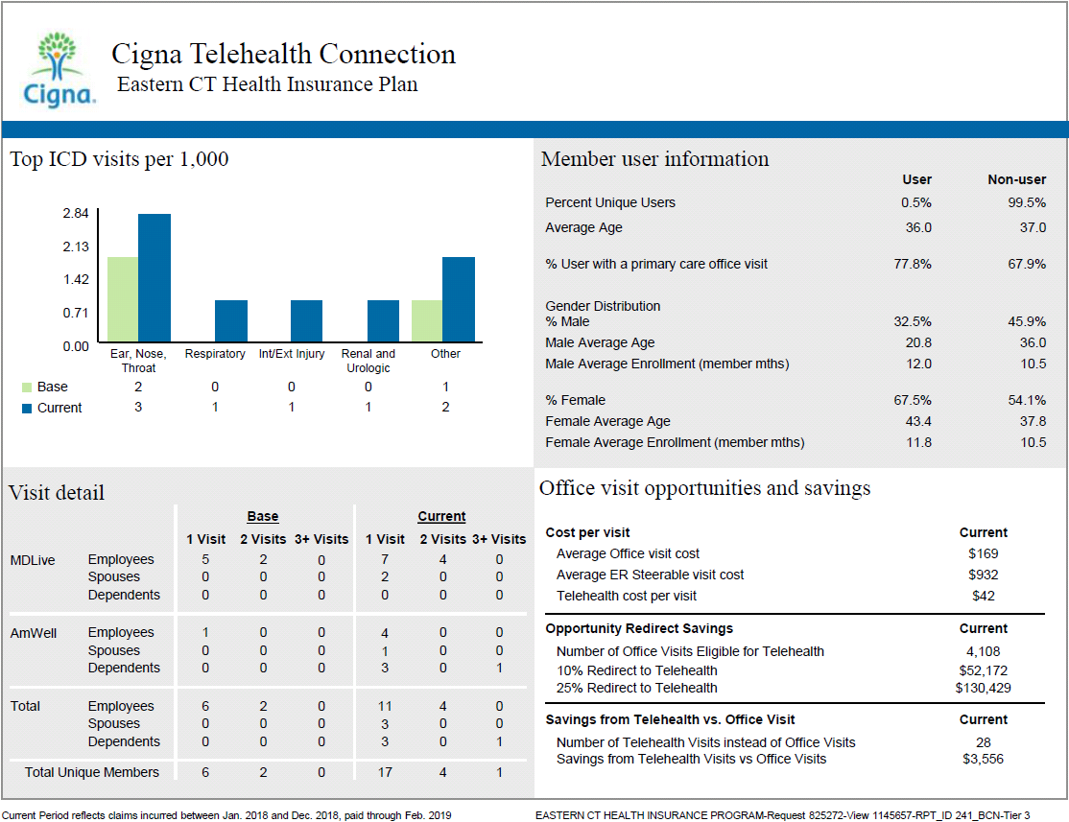

Slide 13




Screenings

Slide 14
How echip compares
Colonoscopies 31%
Cholesterol 69.6%
Mammograms 58.3%
Echip has 31% of the recommended population being screened
Compared to 24.3% - ct public sect norm
69.6% of echip’s population completed cholesterol screenings
Compared to 93% - ct public sect norm
Echip has 58.3% of the recommended
Population being screened
Compared to 64.4% - ct public sect norm

Slide 15
Breaking barriers – 66.7%
Echip’s recommended population shattered the norm of 20.1% for prostate screenings

Slide 16

My cigna cost comparison tool
Download the myCigna® App
Now with fingerprint access, the myCigna® app makes it easier than ever to stay in-network, find facilities and providers, compare costs—and save. Download the app today.
There were 180 steerable er visits identified in the past 12 months resulting in an overspend of $134K
Each er visit was non life threatening and had urgent care or walk-in centers within a 5-10 mile radius

Slide 17
1. Diabetes/circulatory
2. neoplasm
3. depression
4. heart
5. lower back/musculoskeletal
Echip top 5
Our top 5 in claim spend and rx

Slide 18
Diabetes on the rise
7% of our membership is diabetic
4.9% of our membership is pre-diabetic
Trulicity top diabetic drug currently for 13 unique users at annual cost of $86,873
Hypoglycemic rx rank 3rd and insulins rank 4th on our pharmacy spend

Slide 19

Omada integrated diabetes program coming soon
Cigna will be partnering with omada health
On an outreach diabetic program
Flagging type 1 &2 diabetics through email
This program will be pay for performance based on
Group level Performance guarantees

Slide 20




Employee assistance program with esi
Specialized access for our teachers and 1st responders
Coaching, Counseling, financial, adoption, divorce, college preparation, behavioral health, adoption, training
A one stop shop for all our needs!
www.EducatorsEAP.com
www.theeap.com/public-safety-eap
www.eap.com • 1-800-252-4555• 1-800-225-2527

Slide 22

cheers and many thanks to your echip wellness committee
Thank you for your time and dedication
Amanda backhaus – Coventry town
Beth pratt – Coventry boe
Melanie Marcaccio – eastconn
Judy Beausoleil/laurie campagnone – plainfield
Angela Sanchez – Putnam town
Nancy cole – Putnam boe
Mike Wilkinson – tolland town
Suzanne waterhouse – tolland boe

Slide 23


Wellness challenges
Nutrition 101 healthy eating challenge
April 22nd – may 31st
168 participants
Route 66 walking challenge
March 4th – march 29th
221 participants

Slide 25



Get fit summer family fun mystery challenge
This challenge will have you looking for clues to solve the mystery while tracking your daily activity
Two Random Weekly participation prizes per location
$50 for those walking over 8k steps ~ $25 for those under 8k steps
Consistent 4 week participation gets your name entered into the
$500 grand prize drawing

Slide 26


